Slide 1
Multidimensional Array, Bit Manipulation

Slide 2
Contents
Introduction
Array
Why need n-d array
Definition and example
Applications
Working with N-D arrays
Solved problems
Algorithm
Complexity Analysis
Problem: Optimized NAIVE PATTERN SEARCHING

Slide 3
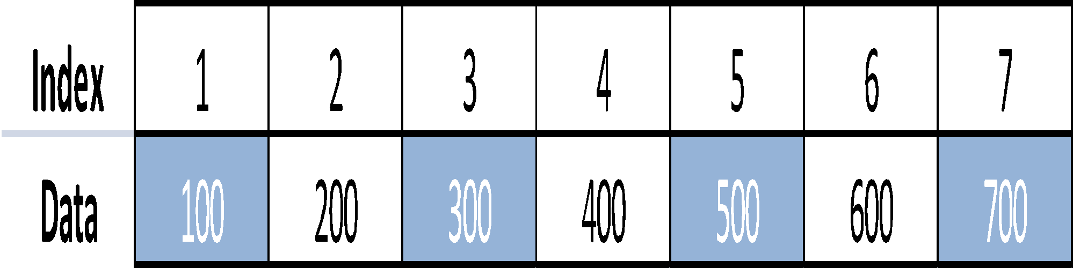
Arrays
Arrays: - Linear DS🡪 Homogeneous (same type) data elements.
Index |  | Data
1 |  | 100
2 |  | 200
3 |  | 300
4 |  | 400
5 |  | 500
6 |  | 600
7 |  | 700

Slide 4
Arrays
Easy to traverse
Easy to search & sort
Used to store relatively permanent collections of data.
Types of arrays:-
Linear arrays
Two dimensional arrays
Multidimensional arrays

Slide 5
Representation of Linear array
LOC(LA[K]) = address of the element LA[K] of the array LA
LOC(LA[K])=Base(LA)+w(K-lower bound)
where w is the number of words per memory cell for the array LA.

Slide 6
Representation of Array in a Memory
The process to determine the address in a memory:
a) First address – base address.
b) Relative address to base address through index function.
Example: char X[100];
Let char uses 1 location storage.If the base address is 1200 then the next element is in 1201.Index Function is written as:
Loc (X[i]) = Loc(X[0]) + i , i is subscript and LB = 0
1200 1201 1202 1203…………..
X[0] X[1] X[2]

Slide 7
Representation of Array in a Memory
In general, index function:
Loc (X[i]) = Loc(X[LB]) + w*(i-LB);
where w is length of memory location required.
For real number: 4 byte, integer: 2 byte and character: 1 byte.
Example:
If LB = 5, Loc(X[LB]) = 1200, and w = 4, find Loc(X[8]) ?
Loc(X[8])= Loc(X[5]) + 4*(8 – 5)
= 1212

Slide 8
Advantages:
1. It is used to represent multiple data items of same type by using only single name. 2. It can be used to implement other data structures like linked lists, stacks, queues, trees, graphs etc. 3. 2D arrays are used to represent matrices.

Slide 9
Disadvantages
We must know in advance that how many elements are to be stored in array.
Array is static structure. It means that array is of fixed size. The memory which is allocated to array can not be increased or reduced.
Since array is of fixed size, if we allocate more memory than requirement then the memory space will be wasted. And if we allocate less memory than requirement, then it will create problem.
The elements of array are stored in consecutive memory locations. So insertions and deletions are very difficult and time consuming.

Slide 10
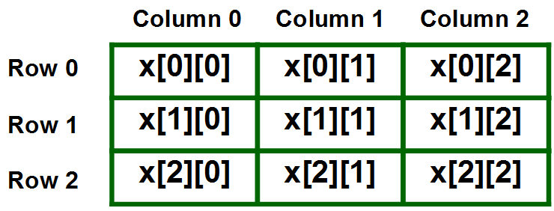
Definition and Example
Multidimensional Arrays in simple words as array of arrays. Data in multidimensional arrays are stored in tabular form.
2-D Array can be seen as a table with ‘x’ rows and ‘y’ columns where the row number ranges from 0 to (x-1) and column number ranges from 0 to (y-1). A two – dimensional array ‘x’ with 3 rows and 3 columns is shown below:
Representation of 2-D Array:
int x[3][4] = {{0,1,2,3}, {4,5,6,7}, {8,9,10,11}};

Slide 11
Need of multi-dimensional array
Multidimensional arrays are used to store information in a matrix form -- e.g. a railway timetable, schedule cannot be stored as a single dimensional array.
You may want to use a 3-D array for storing height, width and length of each room on each floor of a building.
Often used to handle complex data stored in the form of a matrix or table for:
Pixel matrix of an image
Computer graphic transformation matrix

Slide 12
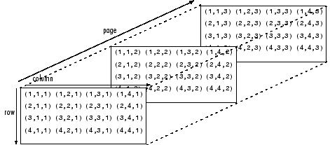
3-D Array
Multidimensional arrays are an extension of 2-D matrices and use additional subscripts for indexing. A 3-D array, for example, uses three subscripts. The first two are just like a matrix, but the third dimension represents pages or sheets of elements.

Slide 13
Applications of N-D Array
Minimum Spanning Tree,
Finding connectivity between nodes,
Matrix-Multiplication
Unlabelled, N-dimensional arrays of numbers, such as NumPy’s ndarray, are the most widely used data structure in scientific computing.
Geoscientists have a particular need for structuring their data as arrays. For example, we commonly work with sets of climate variables (e.g. temperature and precipitation) that vary in space and time and are represented on a regularly-spaced grid.
Often we need to subset a large global grid to look at data for a particular region, or select a specific time slice. Then we might want to apply statistical functions to these subsetted groups to generate summary information.

Slide 14
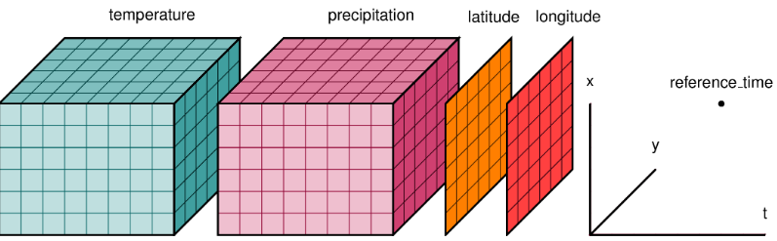
Working with N-D Array
Multidimensional array data are often stored in user-defined binary formats, and distributed with custom Fortran or C++ libraries used to read and process the data.
Users are responsible for setting up their own file structures and custom codes to handle these files.
Subsetting the data involves reading everything into an in-memory array, and then using a series of nested loops with conditional statements to look for a specific range of index values associated with the temporal or spatial slice needed.
Also, clever use of matrix algebra is often used to summarize data across spatial and temporal dimensions.

Slide 15
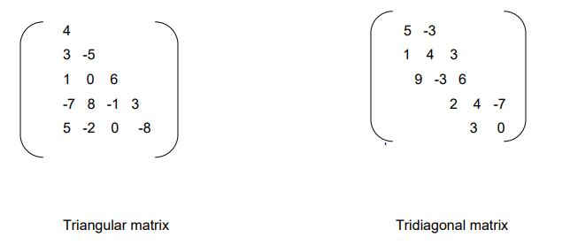
Sparse matrix
Matrix with relatively a high proportion of zero entries are called sparse matrix. Two general types of n-square sparse matrices are there which occur in various applications are mention in figure below(It is sometimes customary to omit blocks of zeros in a matrix as shown in figure below)

Slide 16
Triangular and Tridiagonal matrix
Triangular matrix:
This is the matrix where all the entries above the main diagonal are zero or equivalently where non-zero entries can only occur on or below the main diagonal is called a (lower)
Tridiagonal matrix:
This is the matrix where non-zero entries can only occur on the diagonal or on elements immediately above or below the diagonal is called a Tridiagonal matrix.
The natural method of representing matrices in memory as two-dimensional arrays may not be suitable for sparse matrices i.e. one may save space by storing only those entries which may be non-zero.

Slide 17
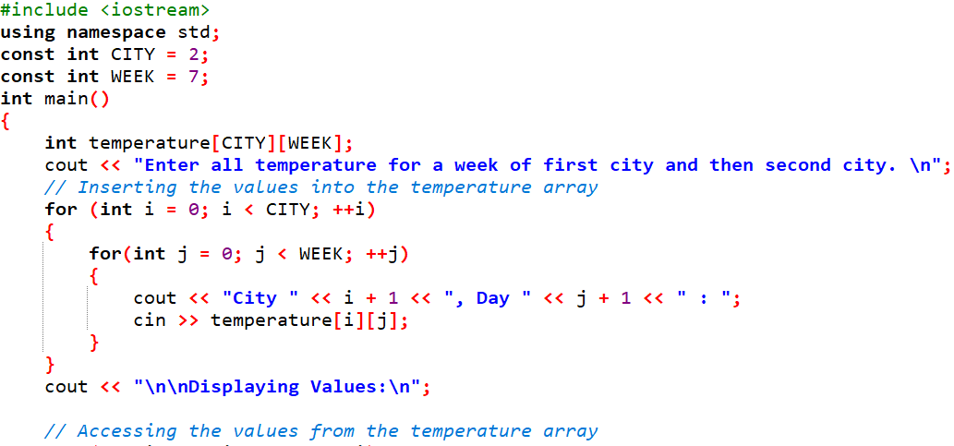
Real life example of 2-D Array

Slide 18
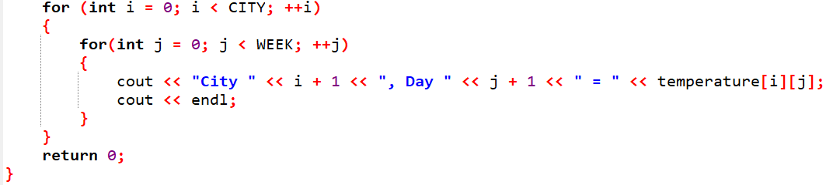
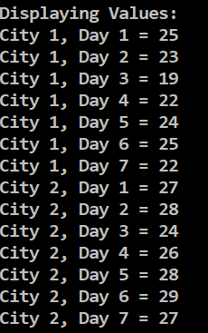
Real life example of 2-D Array
OUTPUT

Slide 19
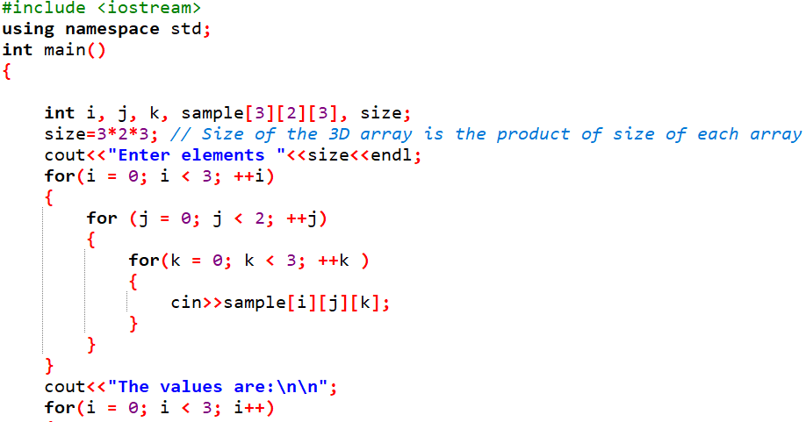
C++ program on 3-D Array

Slide 20
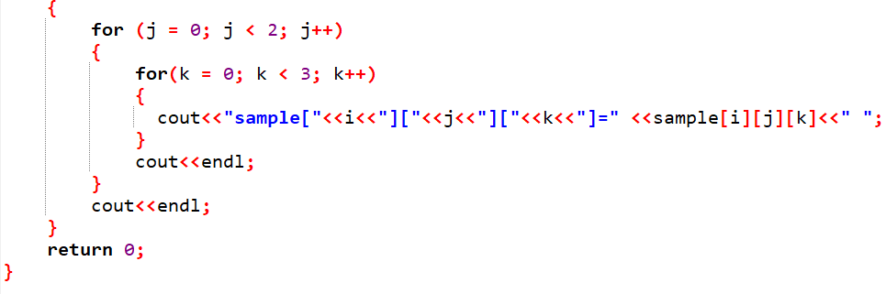
C++ program on 3-D Array

Slide 21
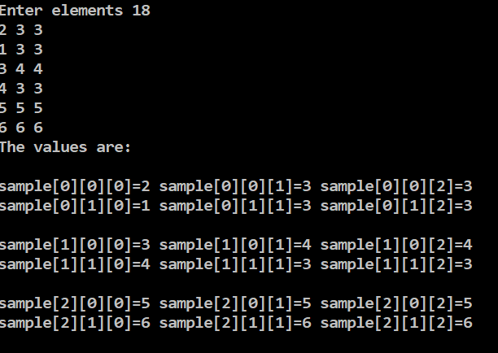
C++ program on 3-D Array

Slide 22
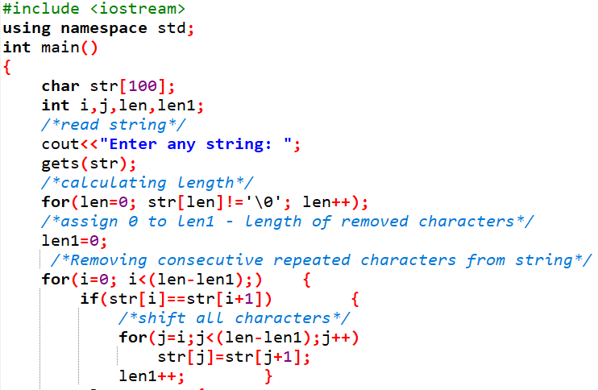
Problems
Program to remove consecutive repeated characters from string

Slide 23
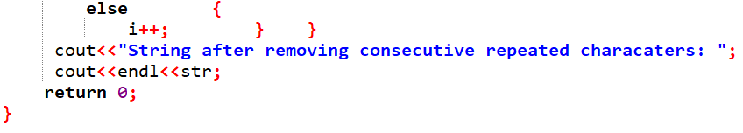
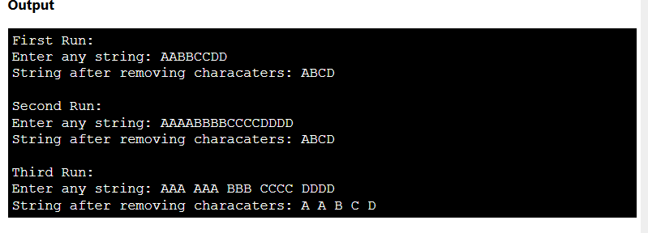
Problems
Program to remove consecutive repeated characters from string

Slide 24

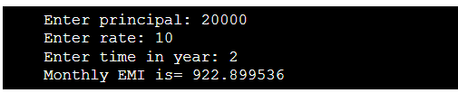
Self Practice Questions
.
1-Age Calculator (C ++program to calculate age) Show output in this form
2-EMI Calculator program in C++Show Output in this form

Slide 25
Bitwise Operations
.
Many situation, need to operate on the bits of a data word –
Register inputs or outputs
Controlling attached devices
Obtaining status
Corresponding bits of both operands are combined by the usual logic operations. Apply to all kinds of integer types
Signed and unsigned
char, short, int, long, long long

Slide 26
Bitwise Operations (cont)
.
& – AND
Result is 1 if both operand bits are 1
| – OR
Result is 1 if either operand bit is 1
^ – Exclusive OR
Result is 1 if operand bits are different
~ – Complement
Each bit is reversed
<< – Shift left
Multiply by 2
>> – Shift right
Divide by 2

Slide 27
Examples
1 | 1 | 1 | 1 | 0 | 0 | 0 | 0
.
1 | 0 | 1 | 0 | 1 | 0 | 1 | 0
NOTE: when signed → all the same
unsigned int
c,a,b;
c = a & b;
//1010 0000
c = a | b;//1111 1010
c = a ^ b;
//0101 1010
c = ~a//0000 1111
c=a<<2;//1100 0000
c=a>>3;//0001 1110

Slide 28
C example…
#include <stdio.h> void main()
{
signed int c, d, a, b, e, f; a = 0xF0F0;
b = 0x5555;
e = 0b01000001; f = 'A';
c = b >> 3; d = a >> 3;
printf("b >> 3 is %x\n",c); printf("a >> 3 is %x\n",d); printf("binary = %x\n",e); printf("char a = %c",f);
}
Output is: b >> 3 is aaa a >> 3 is 1e1e binary = 41 char a = A

Slide 29
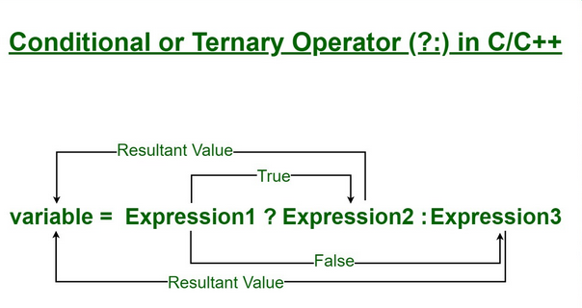
Conditional Operator
Consists of two symbols
Question mark Colon
Syntax: exp1 ? exp2 : exp3
Evaluation:
If exp1 is true, then exp2 is the resulting value If exp1 is false, then exp3 is the resulting value
Example: if a = 10 and b = 15
x = (a > b) ? a : b
b is the resulting value and assigned to x Parentheses not necessary
Similar, but shorter than, if/else statement
.

Slide 30
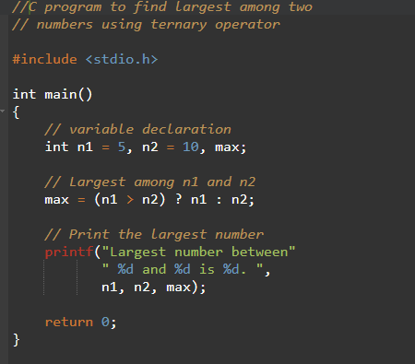
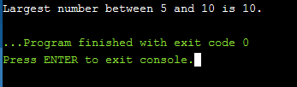
C Programming Code
.

Slide 31
Applications of bit operations
1) They are widely used in areas of graphics ,specially XOR(Exclusive OR) operations.
2) They are widely used in the embedded systems, in situations, where we need to set/clear/toggle just one single bit of a specific register without modifying the other contents. We can do OR/AND/XOR operations with the appropriate mask for the bit position.
3) Data structure like n-bit map can be used to allocate n-size resource pool to represent the current status.
4) Bits are used in networking, framing the packets of numerous bits which is sent to another system generally through any type of serial interface.
.

Slide 32
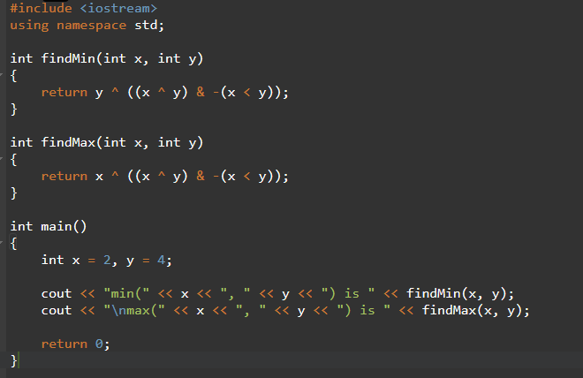
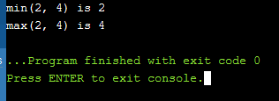
Practice Based Questions
Find the minimum or maximum of two integers without using branching

Slide 33
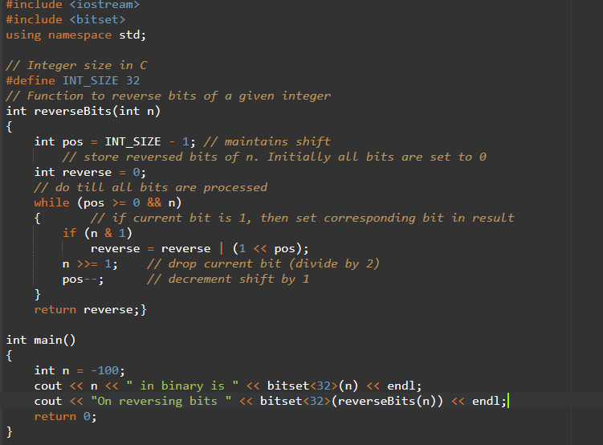
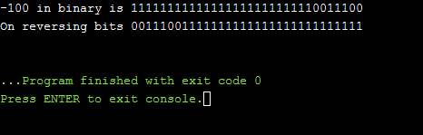
Problem-2
Reverse Bits of a given Integer
.

Slide 34

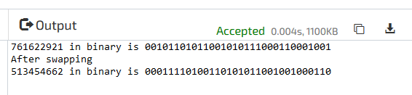
Self Practice Questions
.
Find all odd occurring elements in an array having limited range of elements
Find the below Output
Swap Adjacent Bits of Number
Find the below output

Slide 35
References
https://www.geeksforgeeks.org/naive-algorithm-for-pattern-searching/
https://tutorialspoint.dev/algorithm/pattern-searching-algorithms/searching-for-patterns-set-1-naive-pattern-searching
https://www.tutorialspoint.com/Naive-Pattern-Searching
https://www.researchgate.net/publication/259756537_On_Improving_the_Naive_String_Matching_Algorithm

